Slide 1
eCNN: A Block-Based and Highly-Parallel CNN Accelerator for
Edge Inference

Slide 2
BACKGROUND
Convolutional neural networks (CNNs) have recently demonstrated superior quality for computational imaging applications. Therefore, they have great potential to revolutionize the image pipelines on cameras and displays.
However, it is difficult for conventional CNN accelerators,
to support ultra-high-resolution videos at the edge,
due to their considerable DRAM bandwidth and power consumption.
Therefore, finding a further memory- and computation-efficient microarchitecture is crucial to speed up this coming revolution.

Slide 3
ABSTRACT
A block-based flow to enable high-resolution inference with low DRAM bandwidth.
A hardware-aware ERNet to optimize image quality based on hardware constraints and also build training procedures for model optimization and dynamic fixed-point precision.
A coarse-grained FBISA with parallel parameter bitstreams to provide massive computation parallelism efficiently and flexibly.
An embedded processor, eCNN, to support FBISA with highly-parallel convolution using 81,920 multipliers.

Slide 4
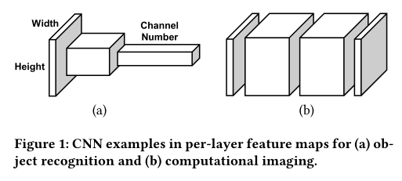
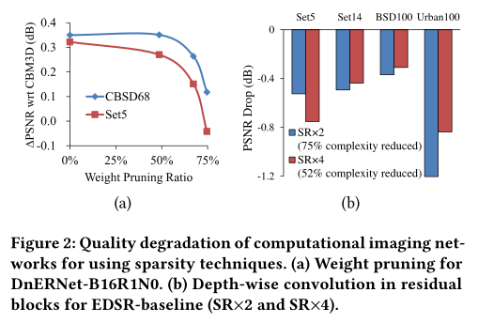
BLOCK-BASED INFERENCE FLOW
Two specific features for computational imaging networks are not considered for optimization:
The spatial resolution of feature maps is not aggressively downsampled.
The models are not very sparse.
The former results in a dramatically-high amount of memory bandwidth, and the latter introduces an extremely-high demand of computing power.

Slide 5
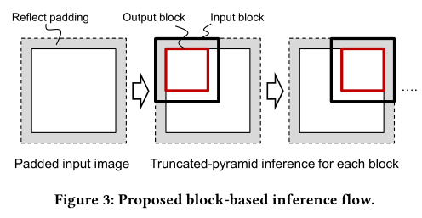
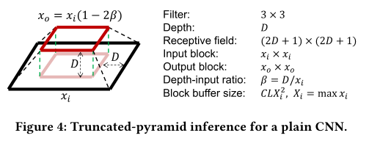
BLOCK-BASED INFERENCE FLOW
Two specific features for computational imaging networks are not considered for optimization:
The spatial resolution of feature maps is not aggressively downsampled.
The models are not very sparse.
The former results in a dramatically-high amount of memory bandwidth, and the latter introduces an extremely-high demand of computing power.

Slide 6
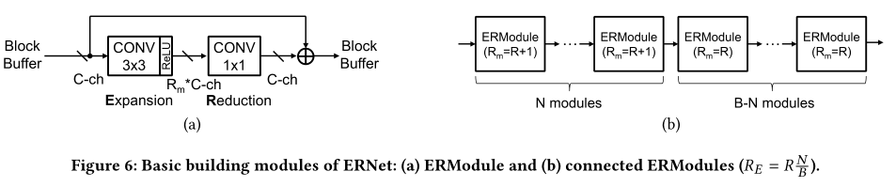
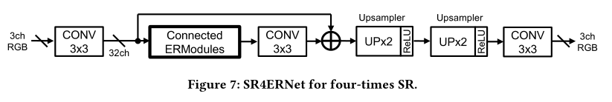
ERNET
Memory Bandwith
To increase its capacity without enlarging the buffer area,
all the operations are performed internally without accessing to block buffers.

Slide 7
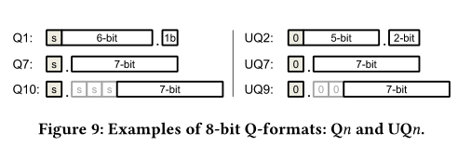
ERNET
Dynamic Fixed-Point Precision
The multiplications and block buffers are both considered in 8-bit precision.
The internal partial sums are accumulated in full precision to preserve quality.
Each convolution layer has its own Q-formats for weights, biases, and feature outputs, respectively.

Slide 8
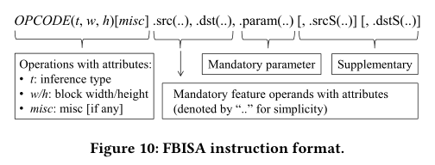
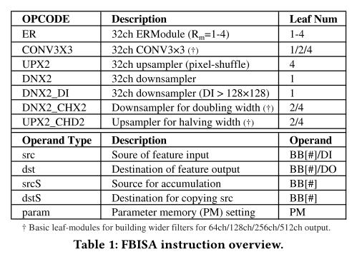
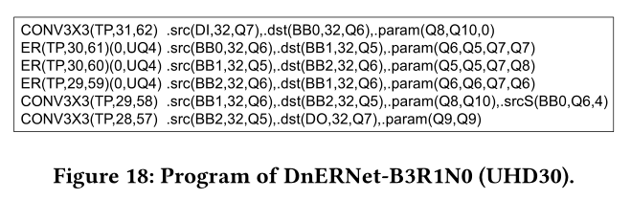
FBISA
The SIMD instructionset, FBISA, to support the truncated-pyramid inference for fully convolutional networks.

Slide 9
FBISA
Two strategies to provide efficient data movement for highly-parallel convolution.
Specified on the basis of block buffers (BBs), instead of conventional small registers or vectors.
Devise operands DI and DO as virtual block buffers for data input and output respectively.

Slide 10
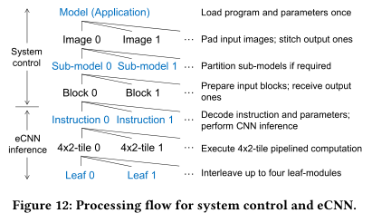
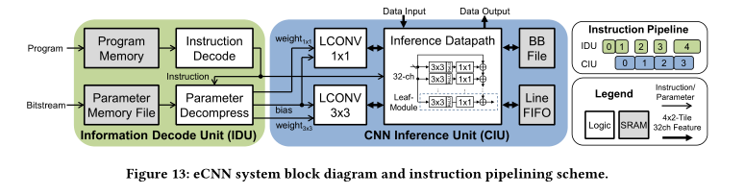
eCNN
This embedded processor is implemented to support FBISA with highly-parallel convolution for high-performance and also power-efficient computing.

Slide 11
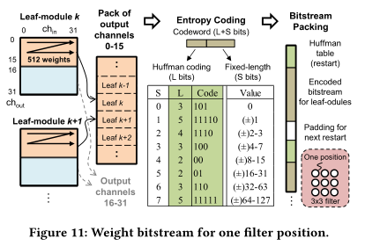
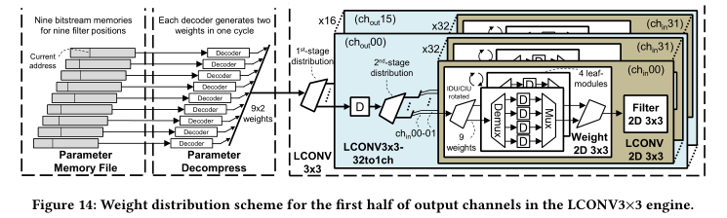
eCNN
Bitstream
In FBISA, we split the filter weights into 20 bistreams to enable parallel loading and distribution of them in the processor: 18 for
CONV3 × 3 and two for CONV1 × 1.

Slide 12
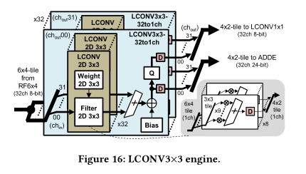
eCNN
Highly-Parallel Convolution Engine
Compared to the conventional accelerators with much fewer multipliers, their massive parallelism enables power-efficient caccumulation of internal partial sums.

Slide 13
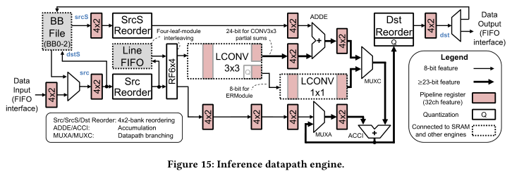
eCNN

Slide 14
eCNN
Tile-Pipelined Inference Datapath Engine
Consists of two functions: input preparation for the LCONV3 × 3 engine and output post-processing for different opcodes and operands.
The first function prepares input 6 × 4-tiles for 3 × 3 filtering, it only read 4 × 2-tiles from block buffers and store them in a line FIFO buffer.
In addition, a data reordering circuit (Src Reorder) is used to address a tile misalignment issue

